Slide 1
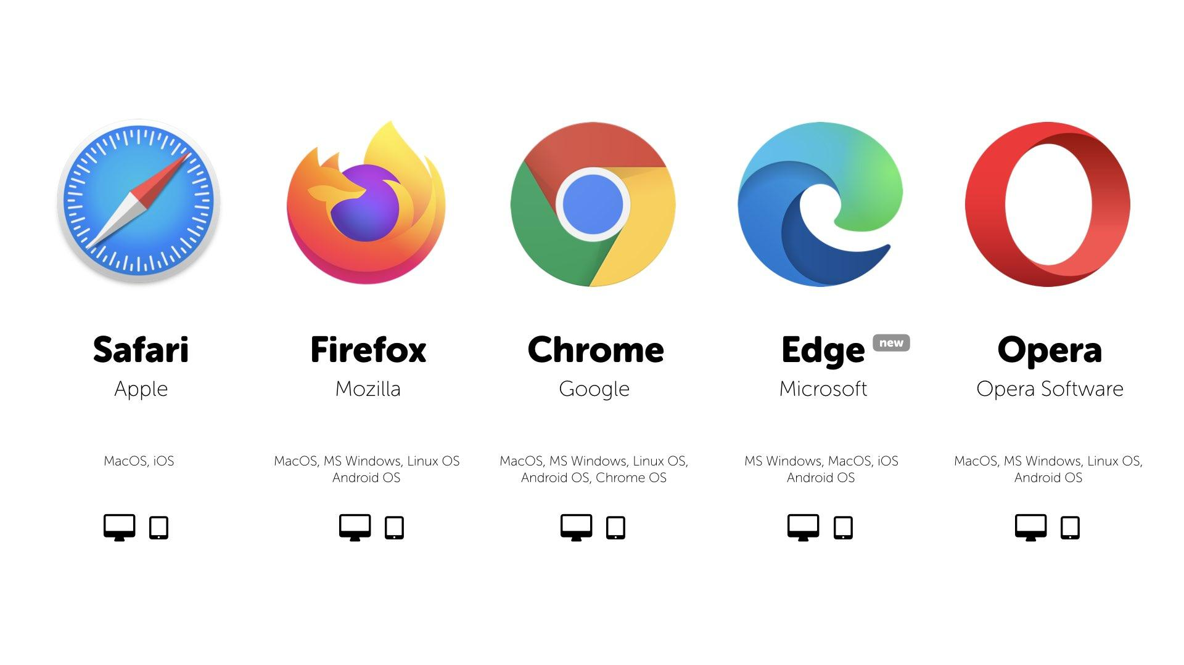
Browsers

Slide 2
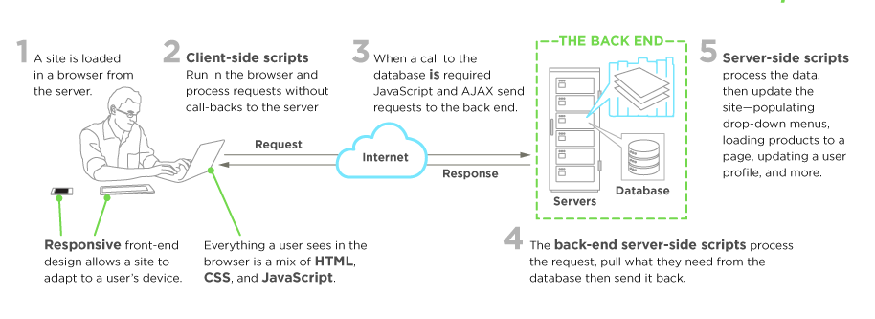
How do websites work?

Slide 3
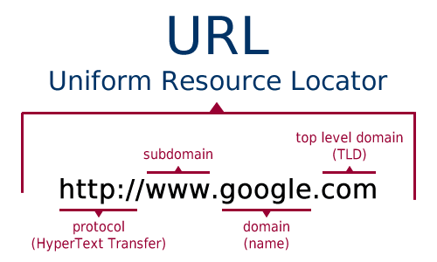
What is a link? Or a URL?

Slide 4
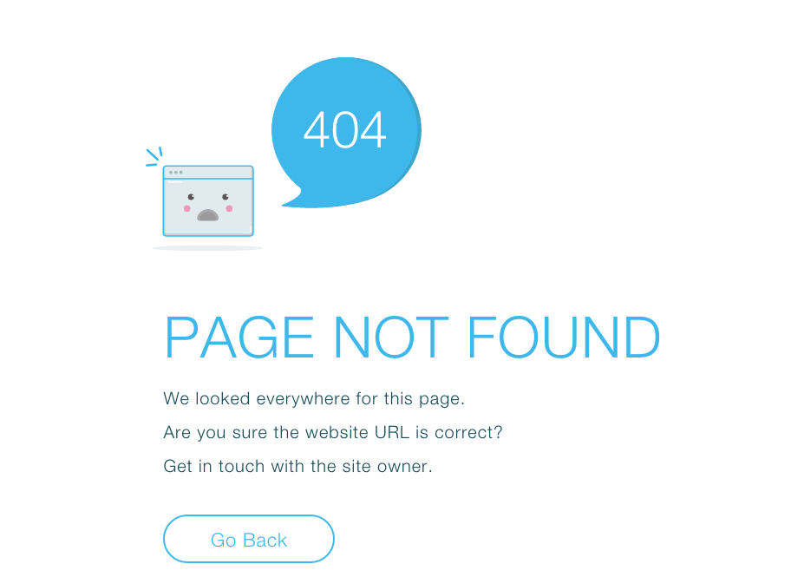
When you make a mistake on your URL then this will happen

Slide 5
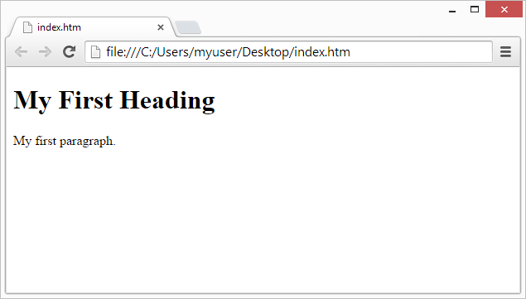
Local link
When a link showing a file in your computer’s directory and not online, this is usually an HTML file.

Slide 6
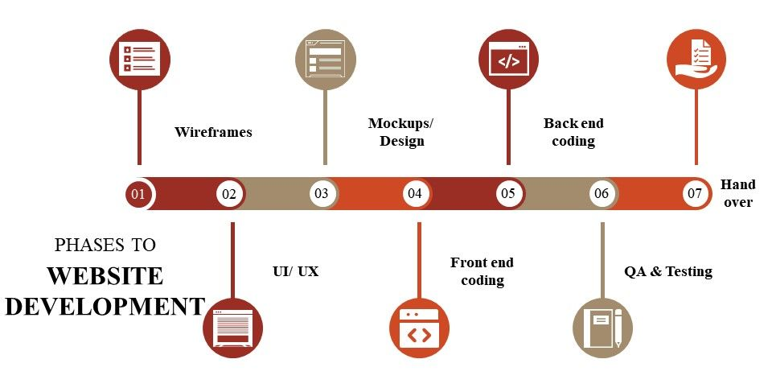
Sitemap

Slide 7
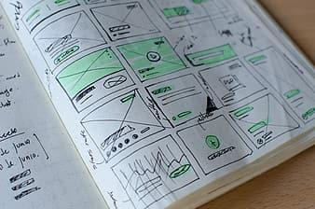
Web Design Process - Sitemaps and Wireframes

Slide 8
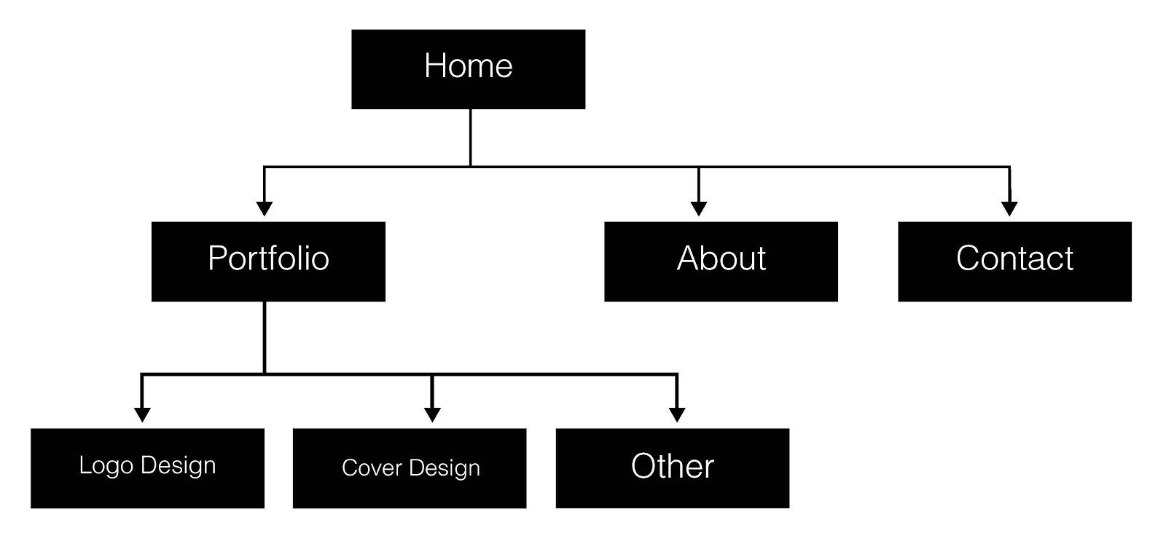
Site Maps
home.html
portfolio.html

Slide 9
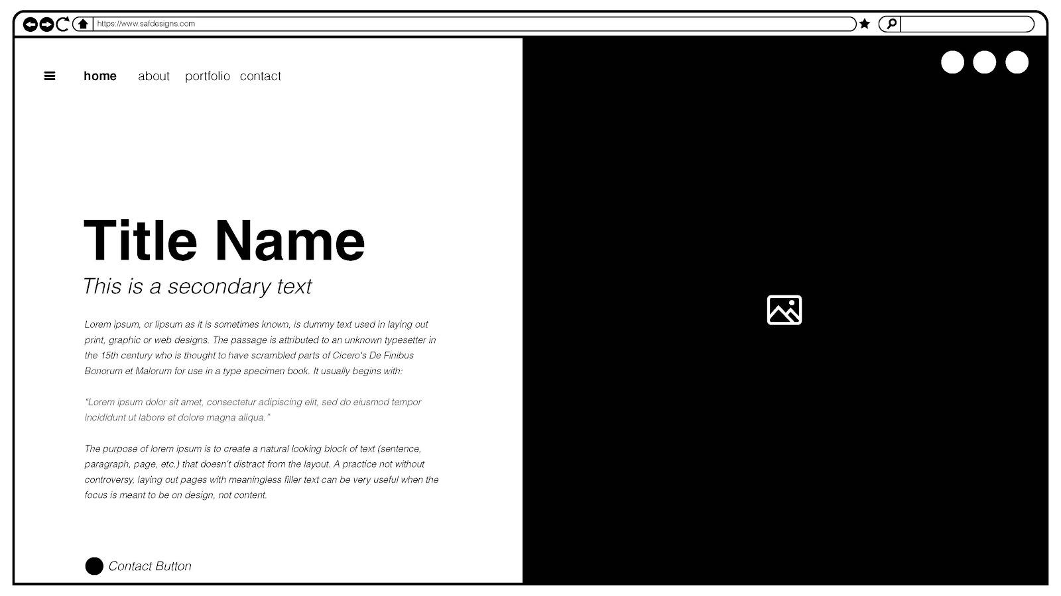
Wire Frame
The look of the website before, it can be a sketch or a well designed digital illustration.

Slide 10

Mock Up Website

Slide 11
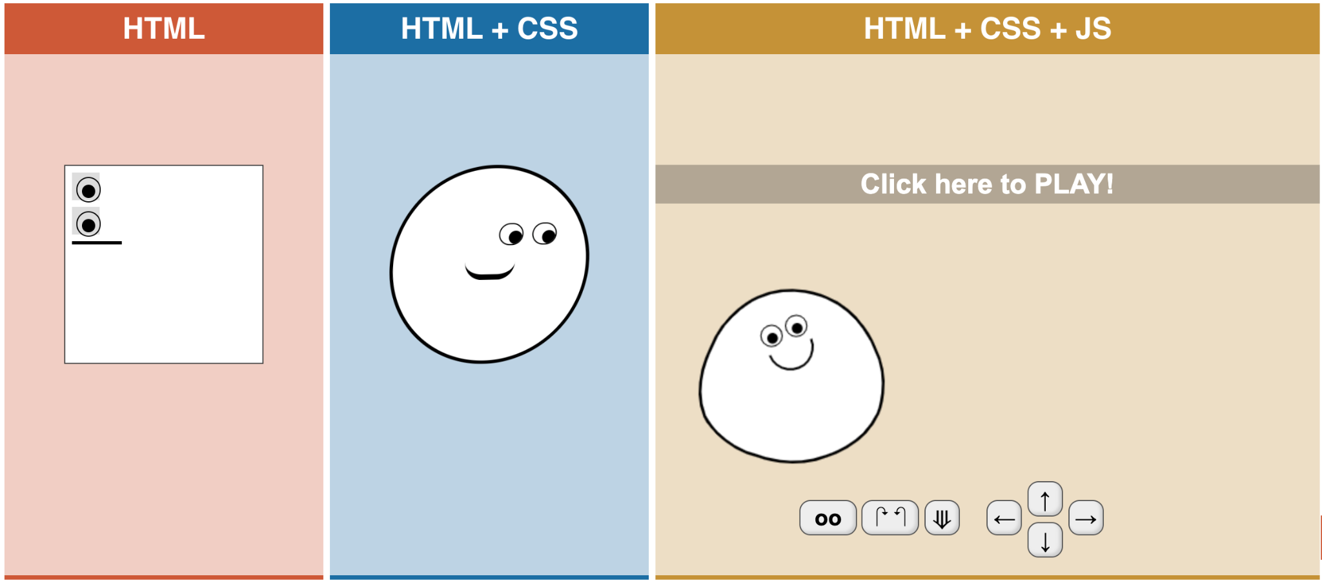
Web Design Basics

Slide 12
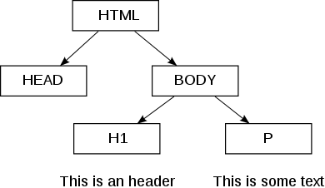
Houses the content
Is read by the browser and only seen if it is a title.

Slide 13
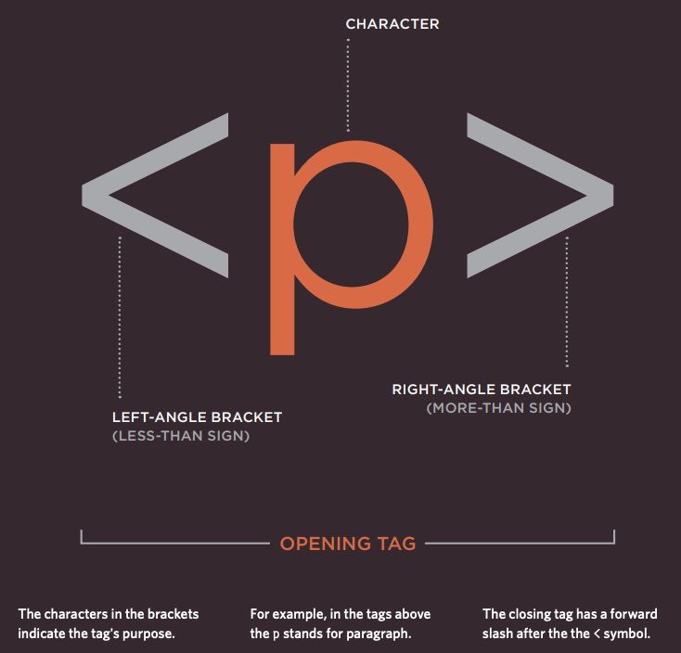

Slide 14
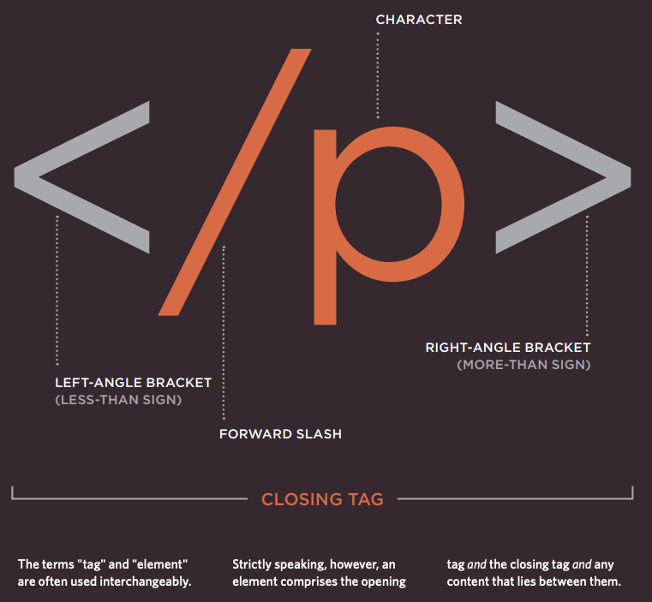

Slide 15
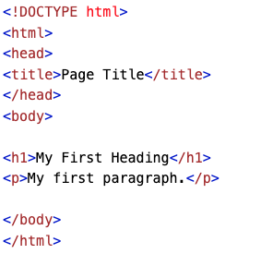
Header
Container
Whole
Website
Main Content

Slide 16
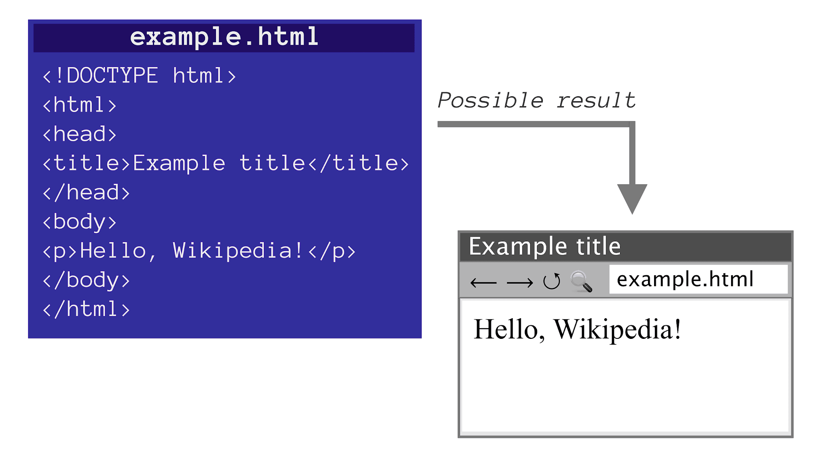
An HTML document is a file containing Hypertext Markup Language, and its filename most often ends in the . html extension. An HTML document is a text document read in by a Web browser and then rendered on the screen.

Slide 17
HTML stands for Hyper Text Markup Language and it is the foundational structure for creating websites. All browsers( chrome, internet explorer, safari, firefox, etc) are able to read HTML, CSS, JS, PHP and other code languages . Although each browser has different specifications when unpacking different code, most of them will read the basic HTML and CSS we will learn in class.
Visit: https://www.w3schools.com/html/html_intro.asp
For a basic HTML tutorial
Note: That all HTML is characterized by <tags></tags>
<p> = Opening p tag, states the start of a paragraph.
</p> = closing p tag, states the end of a paragraph
< = Starts an opening tag
> = Ends an opening tag
Some tags are self closing like <!DOCTYPE html> which don’t require a closing tag and are stand alone. This is recognized by the browser as a statement of what type of file this is and it is placed at the start of any HTML document.

Slide 18
<!DOCTYPE html>
<html>
<head>
<title>HTML Tutorial</title>
</head>
<body>
<h1>This is a heading</h1>
<p>This is a paragraph.</p>
</body>
</html >
Notice that all HTML tags have <> for opening tags and </> for closing
for exp <title></title> or <p></p>
except for <!DOCTYPE html> which is a self closing tag

