Slide 1
What Is A File Format?
Digital Art and Photography
This presentation addresses the following Print Ed Competencies:
IGC C1, 3, 5, 7

Slide 2
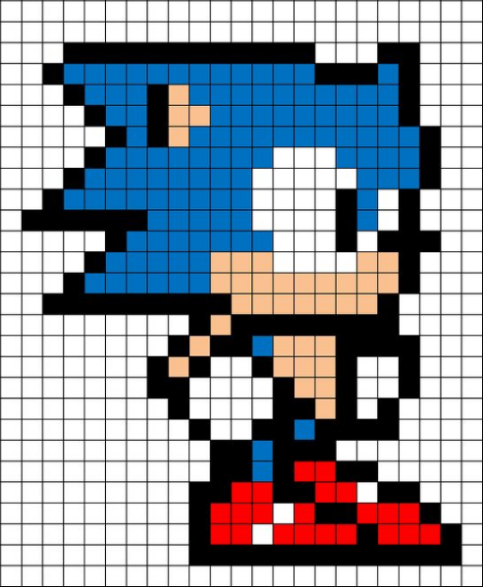
Words To Know
Pixel - A Tiny square of color that is produced by an electronic device. When a group of these squares are tiled together, They form a picture. Think of a mosaic Design
Why do we have them? - An electronic device, computers, cell phones, .etc all communicate with numbers and that is the only way that they can describe color. Each shade of each color that you see on your screen is assigned a number and that color is contained in a little square space or pixel.

Slide 3
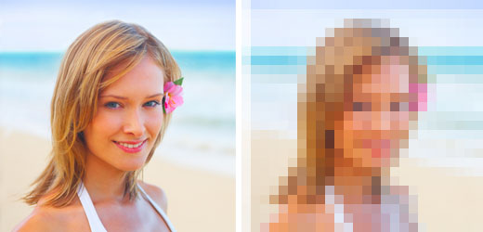
Raster Files Vs Vector Files
Raster files are made up pixels. Photographic images and converted vector files all fall into this category. The resolution of a raster file dictates its size and flexibility.
Raster file viewed at best resolution and physical size.
This is what happens when you view a raster file at a physical size that is too big for its resolution.

Slide 4
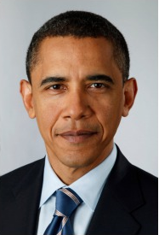
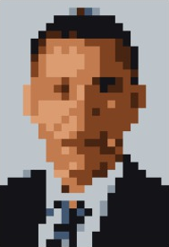
Words To Know
High Rez or High Resolution - Are bigger files. This means that they will take up more room on a hard drive. It does have anything to do with how big a file will be when you print it. High Rez files have more ability to be physically resized without looking blocky because the pixels in them are very small and thus, there are a lot of them. The smaller the pixel, the smoother and more in focus the image will look. Smaller pixels record detail much better than big ones. However these images take longer to load because the computer has to keep track of more pixels.
High Rez - Smaller pixels means more detail and more ability to change the physical size but a bigger file size.
Low Rez - Bigger pixels means less detail and less ability to change the physical size but a smaller file size.

Slide 5
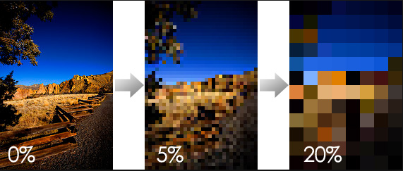
Words To Know
Low Rez or Low Resolution - Have fewer pixels so in order to fill the space and make the image, The pixels have to get bigger. Fewer pixels makes a smaller file that loads faster but when you expand the image, it will degrade and become pixelated which means that outside edges of the individual pixels can be seen. You can see them because the pixels that make up the image got bigger as the image was enlarged and they were already big to begin with.
This image is low rez. When it is enlarged 5%, it already is unusable. At 20% it is unrecognizable.

Slide 6
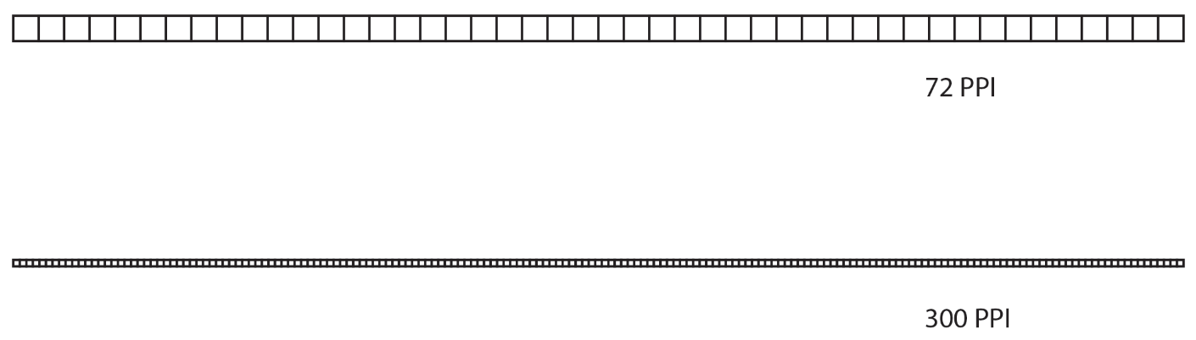
Words To Know
Resolution - This is how we measure the size and quantity of pixels in an image. The term we use to describe resolution is, PPI. This refers to Pixels Per Inch. That means that if you were to take a sample of one line of pixels in an image and only count the pixels in one inch of that line, the number of pixels that you counted would be that image’s PPI or resolution.
Try to think of these two lines of squares as pixels all lined up in an image and then try to imagine that this was actually one inch of that image just blown up. Now think about the size difference in these pixels. These two lines are not drawn to scale the size difference would be much greater in real life.

Slide 7
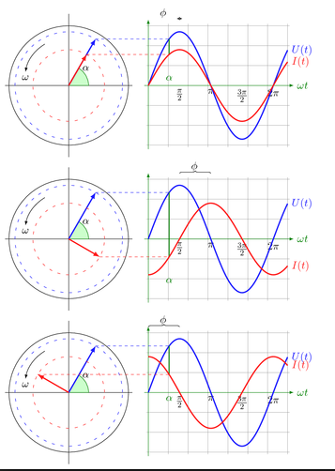
Words To Know
Vector - A line that demonstrates a mathematical equation. (Scary) Don’t worry the computer will do most of the math. You will control the end, beginning and middle of the line by just grabbing them and moving them.
Why do we have them? - An electronic device, computers, cell phones, .etc all communicate with numbers and unlike pixels, these lines are extremely flexible.

Slide 8
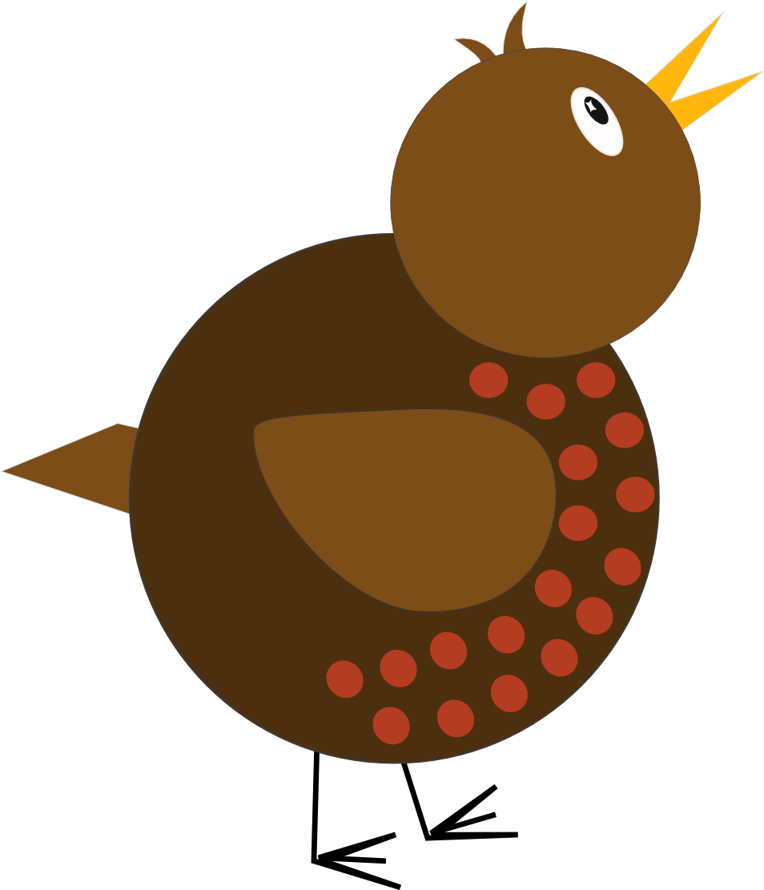
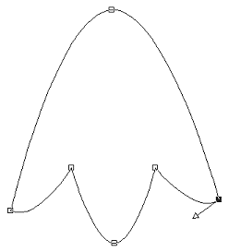
Raster Files Vs Vector Files
Vector files are made up of lines, nodes and handles. They are mathematically based and if you paid attention in your algebra classes, you will notice that the word “vector might sound familiar. Because these files do not have pixels, they do not have resolution, they are very stable and do not degrade no matter how big or small you make them.
Vector Artwork can look kind of hard edged but graceful.
When you view a vector image in Wireframe you see the lines nodes and handles.

Slide 9
Vector Images
Line
Node
Handles

Slide 10

Vector Images
Vector images are the best choice for logos, signage, embroidery and t-shirt designs. They can also be very complex and beautiful designs. Vector images take a little training to create and edit so many ameteur designers do not use or know how to edit them.

Slide 11
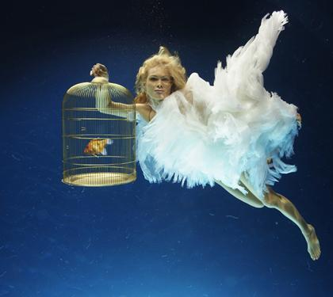
Raster Images
Raster images are best for photography or any continuous tone image. These images have numerous subtle tones and are resolution based. The higher the resolution, the smaller the pixels and the bigger the file size. If you read and think about this statement carefully you should conclude that there is a balance between resolution and the quality of the image.

Slide 12
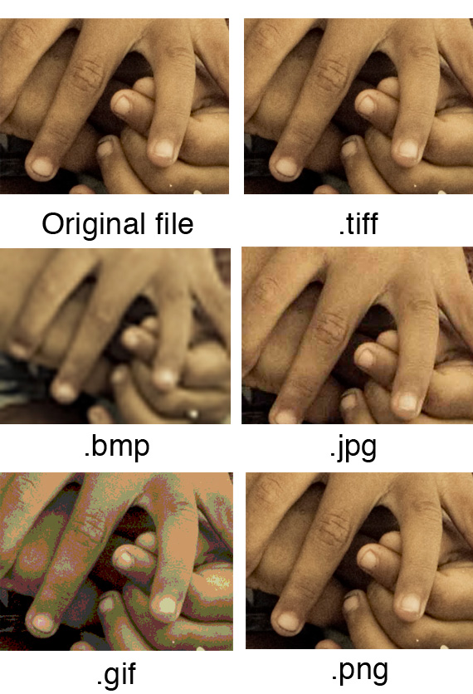
Raster Images- File Extensions
File Extensions are the letters that following the period in the file’s name that tell a computer how to interact with that file. These are a few of the extensions that are appropriate for raster files.
RAW - Preserves the most image information. For editing only. For more information on this file, Click Here
.tiff - Highest quality and most stable image file.
.psd - Native Photoshop file. Preserves layer info but can only be edited in Photoshop.
.jpg - Most common image file. Small does not reserve layer info.
.png - Smaller image file that preserves transparency.
.gif - Smaller image file that can be animated.
.bmp - Low resolution image file.
.pdf - Portable document file. Can be used on both raster and vector information.

Slide 13
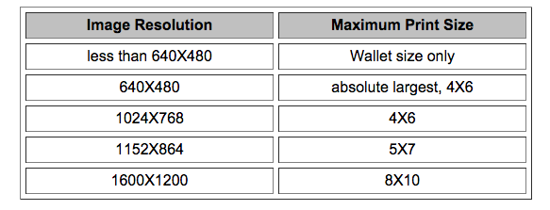
What is Resolution
Resolution is a balance between physical size of the image and the physical size of the pixels in the image.
PPI Is how we measure pixel size. PPI stands for pixels per linear inch.
Images intended for the web are saved @ 72ppi at the physical size that they will be viewed at.
Images that are intended to be printed are saved @ 300 ppi, their physical size can be reduced or enlarged by 60%. without degrading.
Click here for more information on this subject.

Slide 14

Vector Images- File Extensions
These have the ability to preserve vectors. If you save a vector file with a raster based extension, they will become raster files and all vector information will be lost.
.indd - Native InDesign file format. Can preserve layer, vector, style and raster information.
.ai - Native Illustrator file format. Can preserve layer, vector, style and raster information.
.eps - Portable file for vector or raster information.
.pdf - Portable file for vector or raster information.
.fh3 - Native Freehand file format. Can preserve layer, vector, style and raster information.
Because raster files are not resolution based, they will not change in sharpness or pixilate, no matter which vector extension you use.

Slide 15
File Extensions Considerations
And Tips to Remember
Any extension listed as a native file format can only be opened in the program that created it. Some of those discussed were: . psd, .ai, .indd, .fh3
Once you save a vector file with a raster format the vectors are gone for good.
Raster files are resolution based. So you need to be careful when you make adjustments and watch the balance between physical size and resolution.

